Slide 1
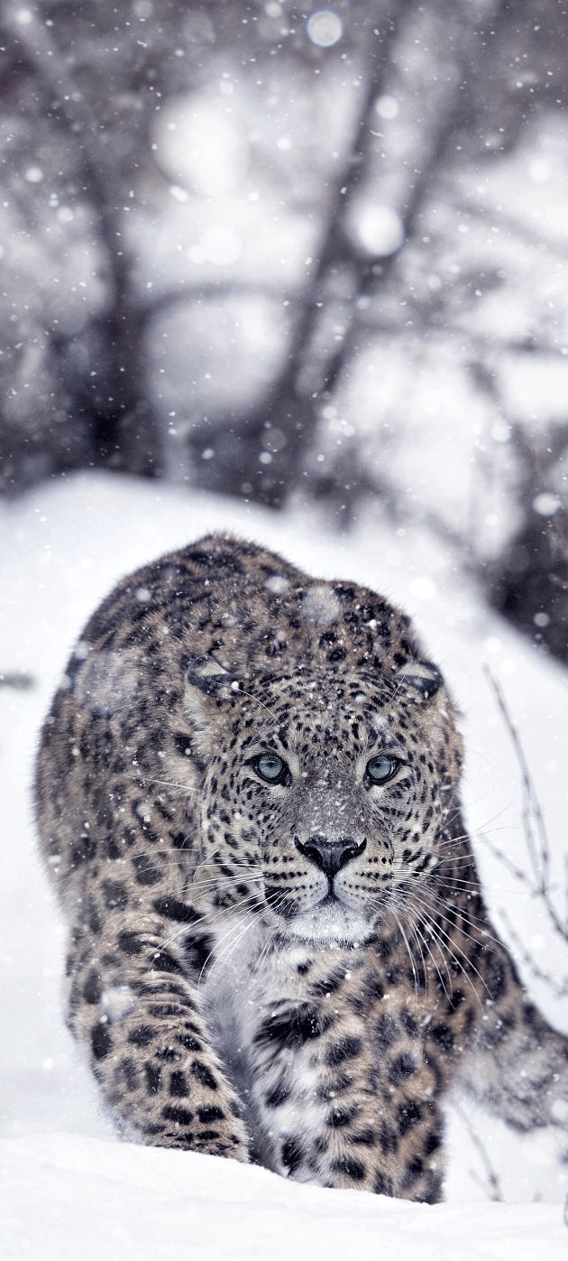
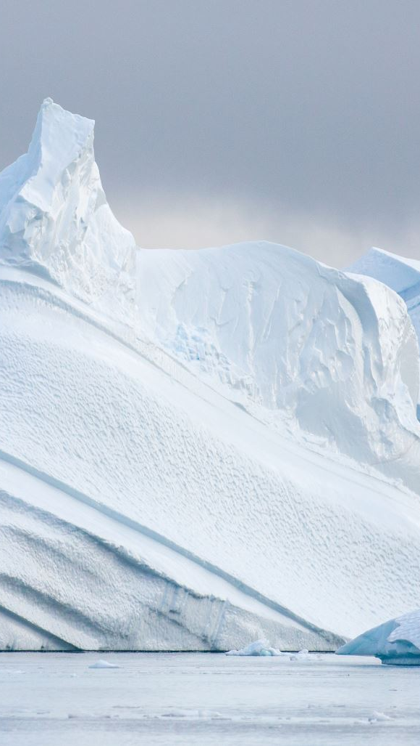
Feline Classification ML Model
By Johnny, Karen, Michael, Fernando, Norman, Nico
Notes:
Karen

Slide 2
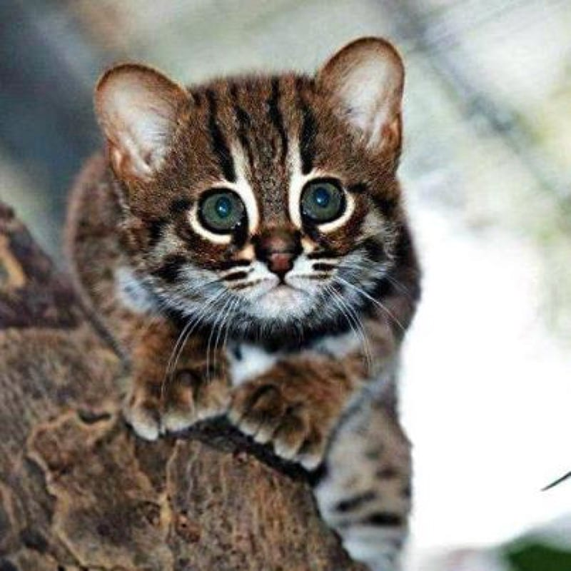
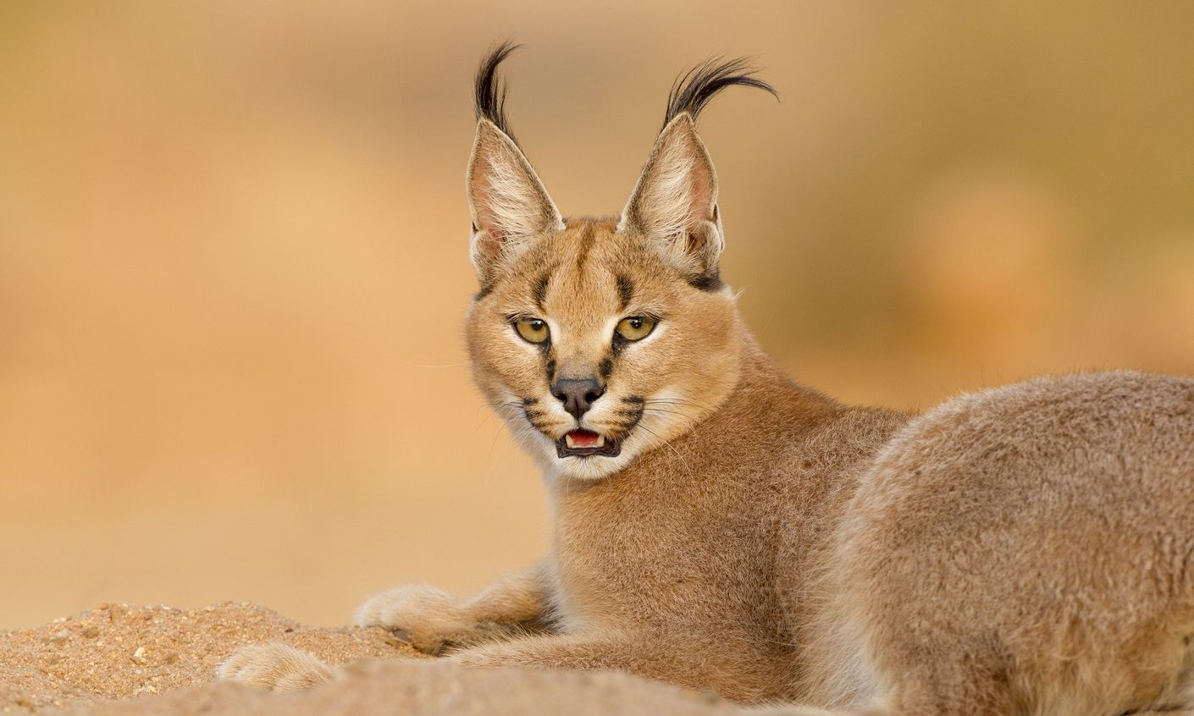
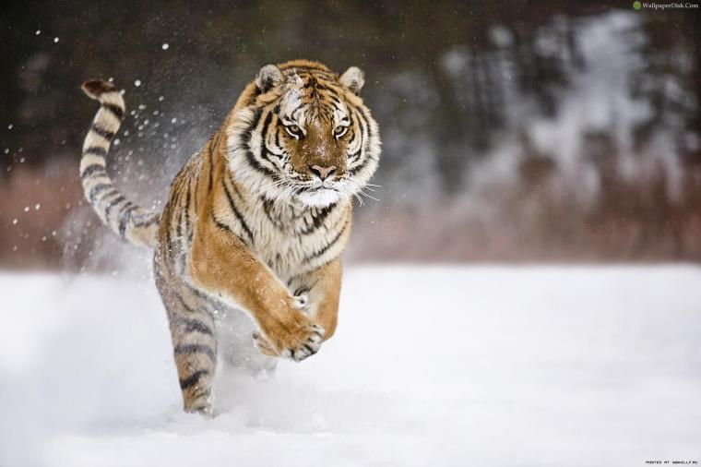
Project Overview & Agenda
Story behind the Data: This project aims to expand on the story of endangered species and how machine learning, specifically classification, can be utilized to further support conservation efforts and awareness.
Approach
Data Source
Cleaning the Data
ML Model
Challenges
Demo
Q & A
Notes:
Karen

Slide 3
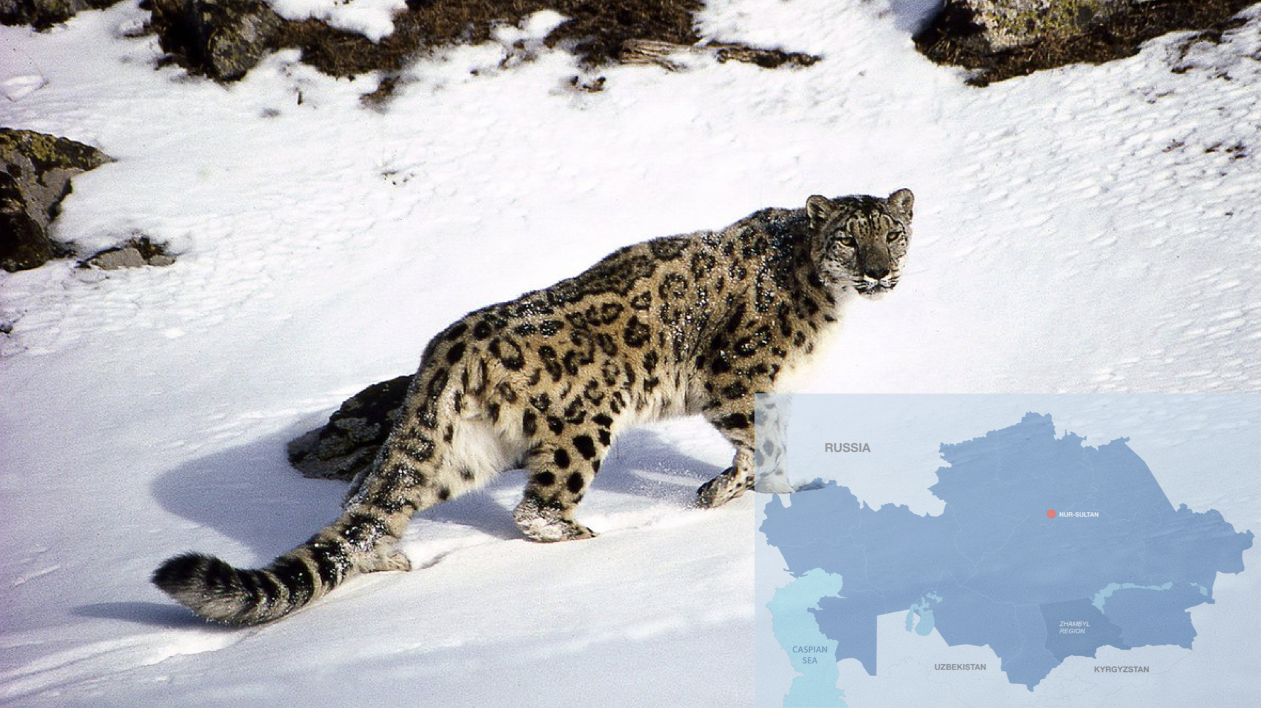
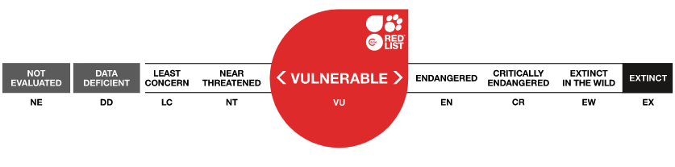
Inspiration
Snow Leopard Trust Project
By Microsoft’s AI for Earth
The AI for Earth program connects researchers in environmental science with the AI and computing resources they need to accomplish their goals.
The Need: Snow leopards are apex predators in Central Asia, known as “ghosts of the mountains” due to their elusive nature. Their population is a key indicator for the health of the whole ecosystem, but they can be difficult to spot and track in the wild.
The Idea: Scientists use camera traps to spot snow leopards in their natural habitats with minimal disruption. Camera traps capture hundreds of thousands of images that need identification and analysis, a labor-intensive task that can be streamlined with AI services.
The Solution: Using Machine Learning to automate image classification, allowing researchers to find well-camouflaged snow leopards within image sets more quickly.
Notes:
Johnny

Slide 4
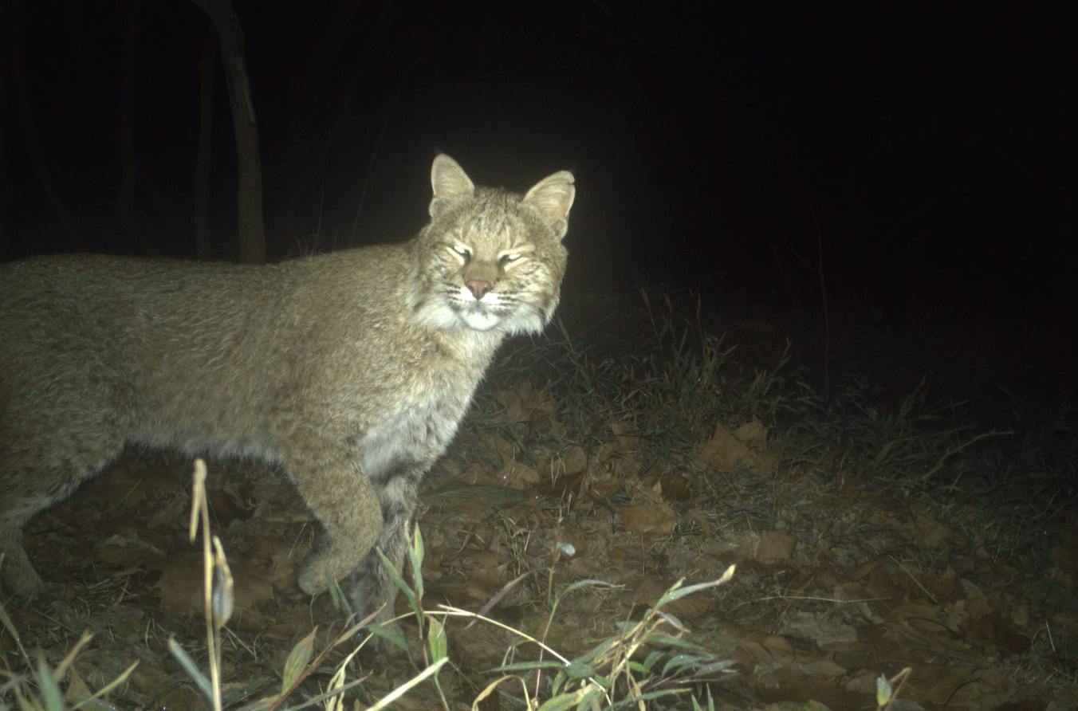
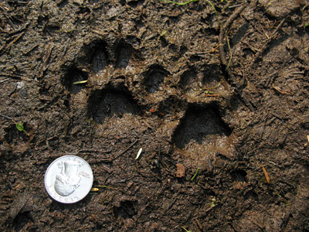
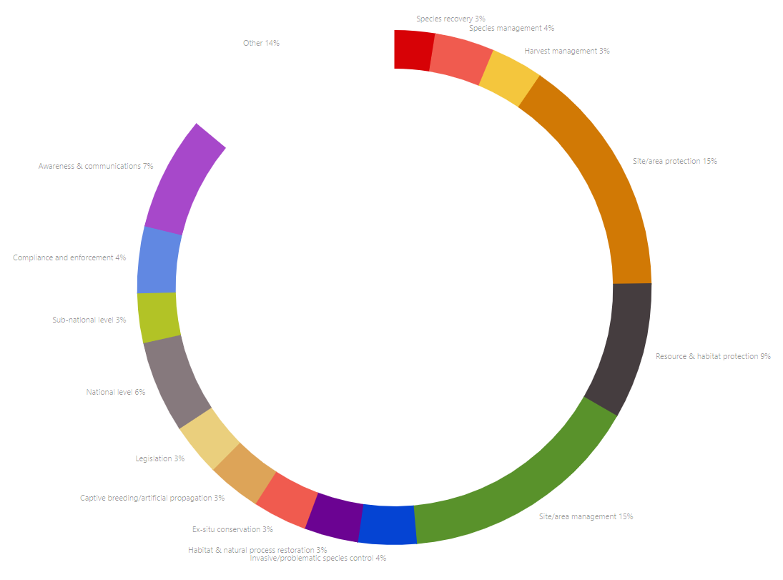
Project Development
Top Conservation Efforts
Site/area management and protection
Resource protection
Awareness and communications
Common Threats
Loss of Habitat
Human Conflicts
Global Warming
Advantages of Using AI to Combat the Issue
Informs proper allocation of resources towards the most needed/effective conservation efforts
Helps redirect human conflicts such as placement of infrastructure, logging activities, etc
Automation makes integration with awareness applications seamless
Notes:
Karen

Slide 5
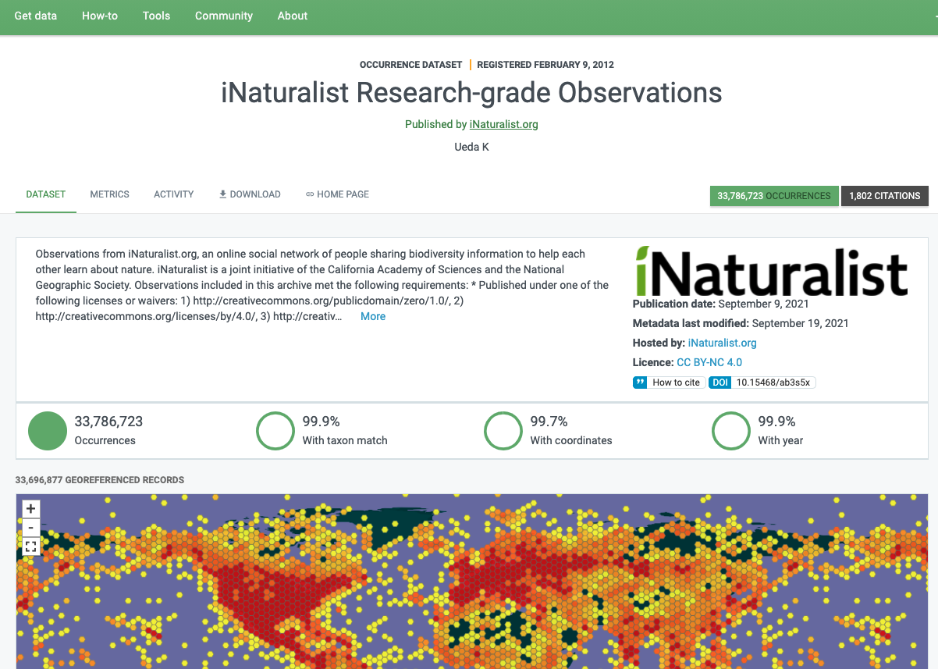
About the data
Data Source: iNaturalist
What is iNaturalist?
An online social network of biodiversity information to help society learn about nature. iNaturalist is a joint initiative of the California Academy of Sciences and the National Geographic Society.
How is it used?
Anyone can record their observations from nature. Members record observations for numerous reasons ranging from science projects, school projects, or simply just personal fulfillment.
Notes:
Johnny

Slide 6
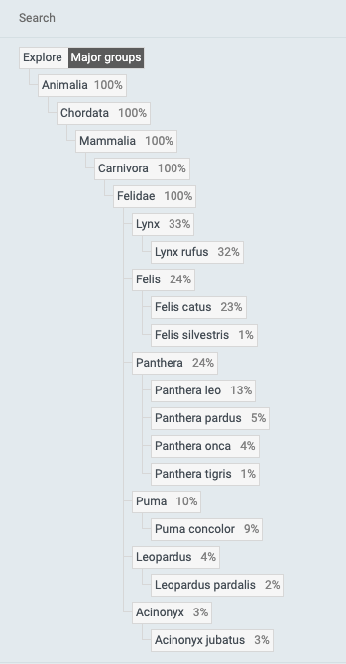
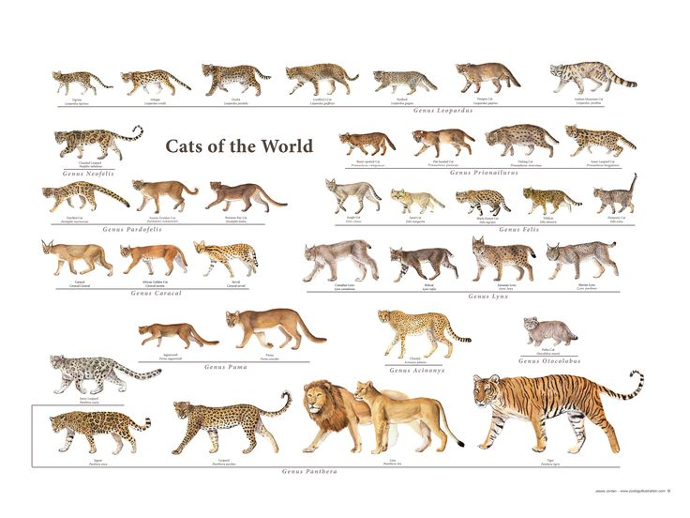
About the data
Focus: Felidae Family
Big cats are some of Earth's largest and most threatened predators. Not only are large predators the most vulnerable to human pressures, but they are the first to disappear from ecosystems and efforts to conserve them effectively help protect thousands of other species that share their habitat.
Notes:
Johnny

Slide 7
Code Flow
Using the Flask frame work a user initiates a request from app.py
The Flask app references instructions in app.py and returns an HTML page
The HTML page references JS (app.js) code instructions
JS then makes a request back to Flask
Flask then loads ML Model and makes prediction
Prediction is return as JSON
Data is then rendered in HTML format referencing CSS for style
Any further requests on the HTML page repeat steps 4 – 7
Flask App (app.py)
HTML Page
JS
(app.js)
ML
Model
(FastAI)
CSS
(style.css)
Google Drive
Collab
Notes:
Fernando

Slide 8
Code Flow-continued
09. Upload data to Google Drive
10. Create URL list ML model
11. Prepare data for ML model
12. ML neural network splits images into train and test groups to verify model
13. ML Model is trained
14. ML Model is evaluated
15. ML Model is adjusted
16. ML Model is then saved in pickle to print
Flask App (app.py)
HTML Page
JS
(app.js)
ML
Model
(FastAI)
CSS
(style.css)
Google Drive
Collab
Notes:
Fernando

Slide 9
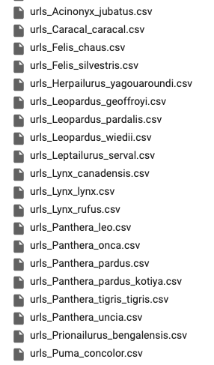
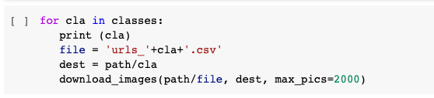
Cleaning the data
Load the all data into jupyter and create usable file names specified for each of the scientific name of the species to simplify downloading
Then create a text file list of the image urls available for each species and store in csv to be used in Collab to run downloads
Remove the folders of species that had limited image urls available before training model
Find top losses from model and manually delete them in ImageCleaner
Notes:
Micheal

Slide 10
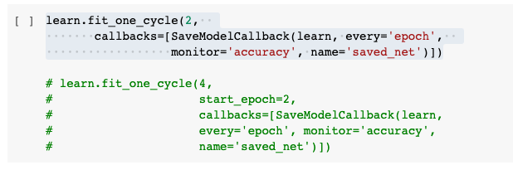
Challenges With Model
Model was hard to train due to disconnects from server when learning after a few hours
Was able to increase training speed by removing some classes - this also ultimately reduced the error rate as the removed classes were the ones with the least amount of images
Learning process was made easier by having each epoch save after completed to resume on most recent epoch if needed
Notes:
Micheal

Slide 11
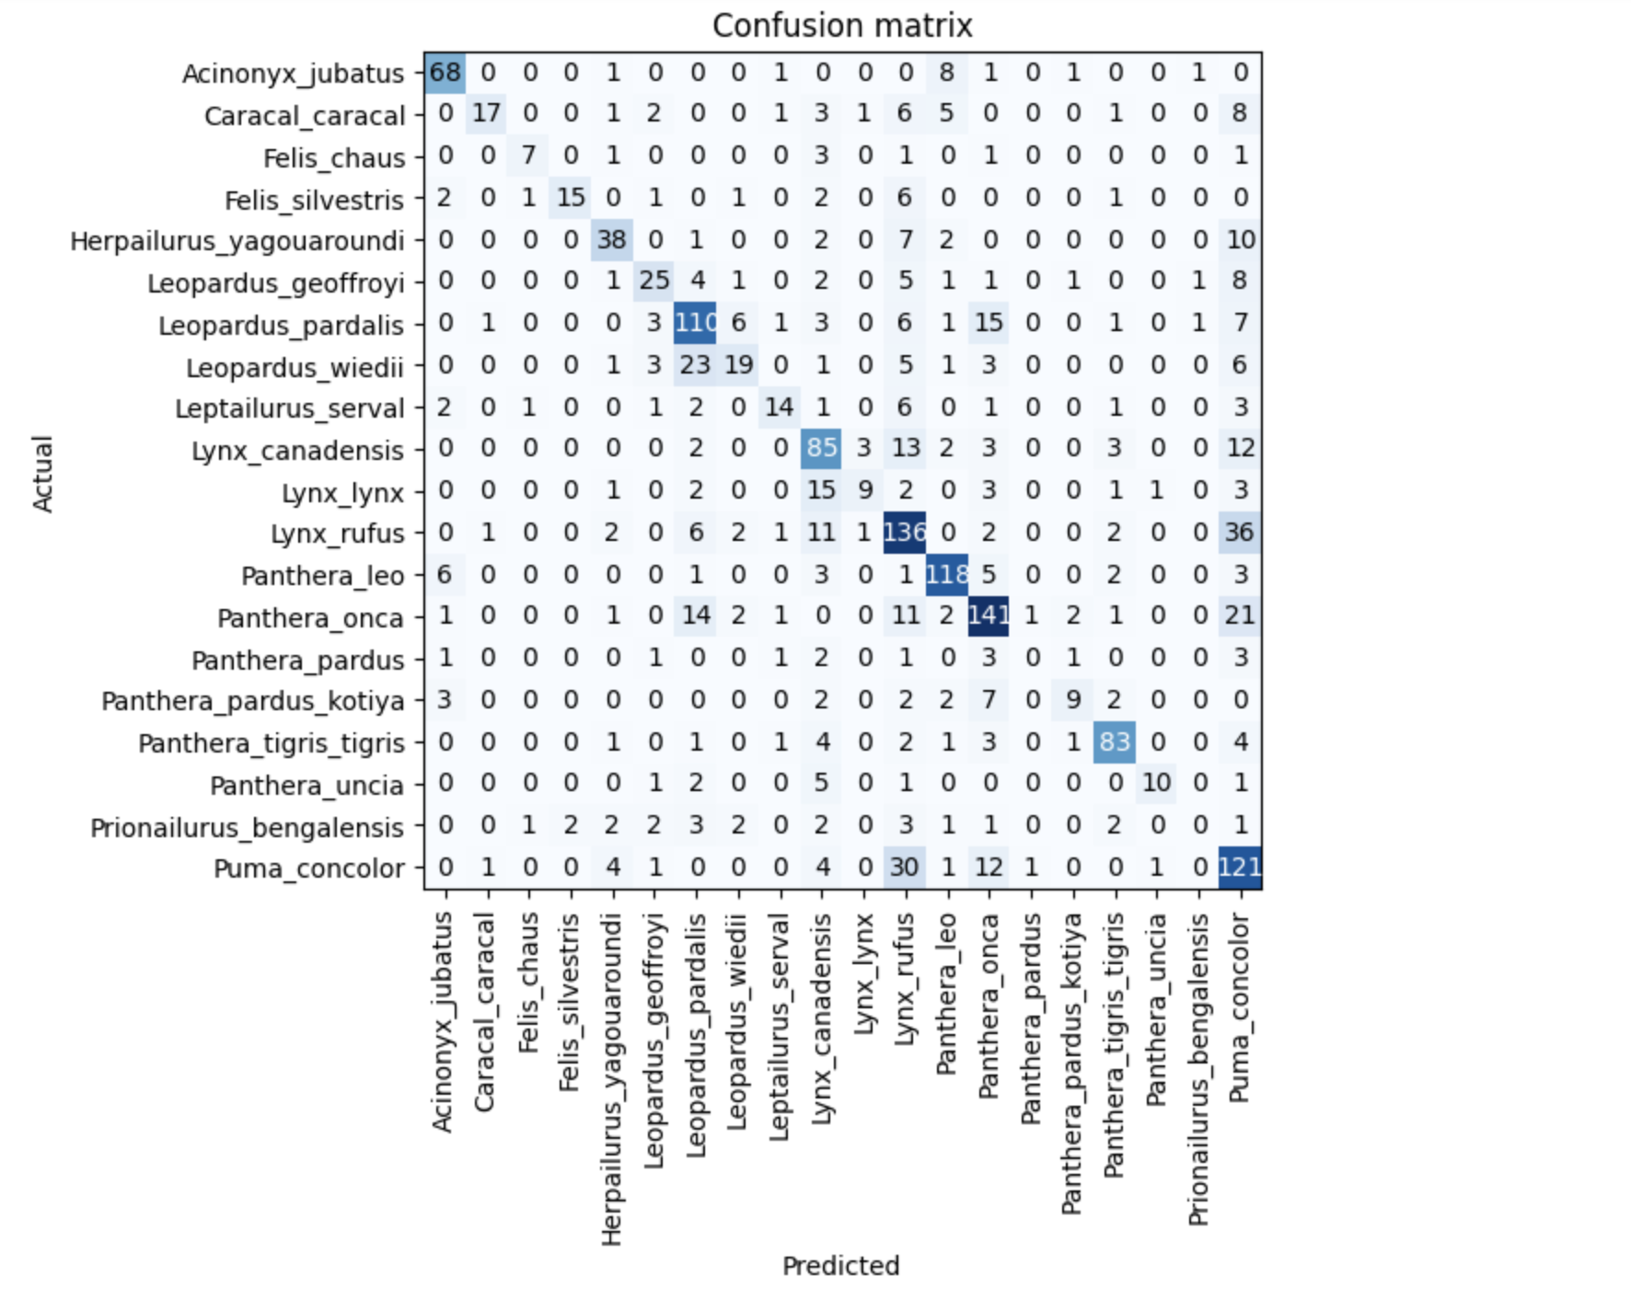
Confusion Matrix
From the results of our matrix we can see that one of the most accurate species predicted was the Lynx Rufus
The main reason for this was due to the fact that this species had the most image data on hand
Most of the losses within the model are a result of different images within the data like paw prints and other objects in the foreground
Panthera Pardus had no correct predictions, not enough images, bad quality, etc.
Notes:
Micheal

Slide 12
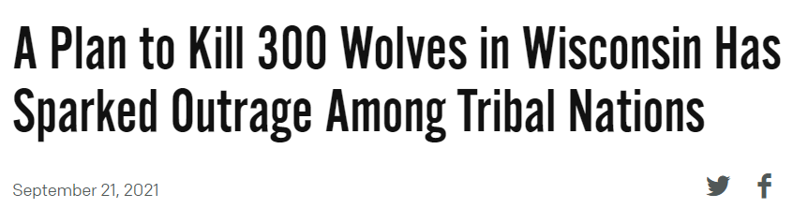
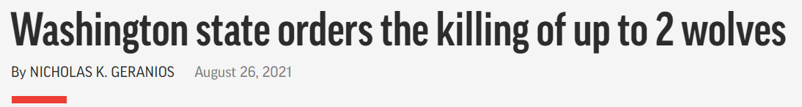
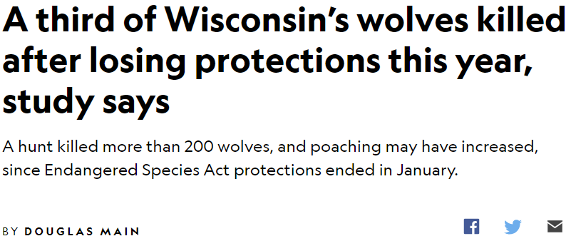
Notes:
Nico

Slide 13
Antidote to extinction
Provide an informational and functional tool for individuals who venture into territories with potential sighting of these endangered species
The IUCN (International Union for Conservation of Nature) Red List recently included 30,178 species that are threatened with extinction¹. There are between 200 and 2,000 extinctions every year².
Essentially, between two and 20 species go extinct EVERY DAY..
1 https://www.iucn.org/
2 https://www.worldwildlife.org/
Notes:
Nico
Informs proper allocation of resources towards the most needed/effective conservation efforts
Helps redirect human conflicts such as placement of infrastructure, logging activities, etc
Automation makes integration with awareness applications seamless

Slide 14
Antidote to extinction
2. Aid the efforts of conservationists to rescue and monitor endangered species in multiple habitats with real-time data and integration with a continuous learning model.
The United States Department of Agriculture is a notorious culprit, last year killing 2,713,570 wild animals from 319 species, though the group most targeted was birds, European starlings to be specific. Last year a hunter in Utah who shot a grey wolf he mistook for a coyote—the first of its species spotted around the Grand Canyon in 70 years—got off scot free³.
3 https://animalogic.ca/news/killing-endangered-creatures-by-mistake-is-way-more-common-than-youd-like-to-believe
Notes:
Nico
Informs proper allocation of resources towards the most needed/effective conservation efforts
Helps redirect human conflicts such as placement of infrastructure, logging activities, etc
Automation makes integration with awareness applications seamless

Slide 15
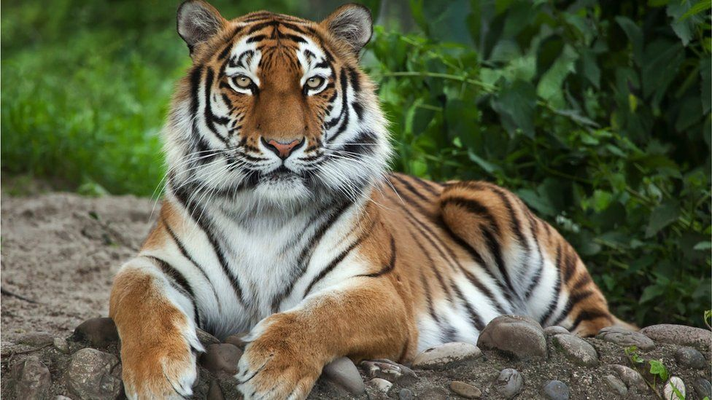
rawr
Notes:
Nico

Slide 16
There are 3,900 tigers in the entire world.
Notes:
Nico

Slide 17
PROJECT Demo
Notes:
Micheal

Slide 18
Questions?
Notes:
Norman

Slide 19

WHAT IF HUMANS NEVER EXISTED?
Notes:
Nico

